Slide 1
CPS-LAB 1
Let’s break the ice.

Slide 2
Effective Communication Skills

Slide 3
COMMUNICATION
Why is this important
What does it mean
Types of communication skills
Explore each of the 4 keys skills
Get that job
Questions

Slide 4
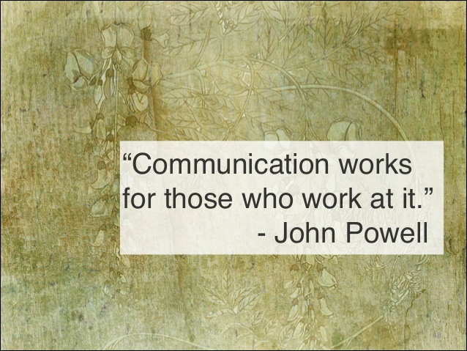
Reflect and Share your thoughts!

Slide 5
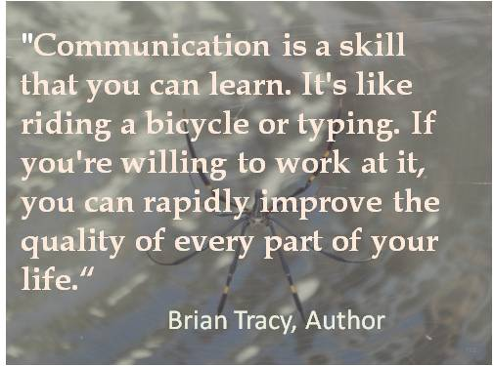
A piece of Advice!

Slide 6
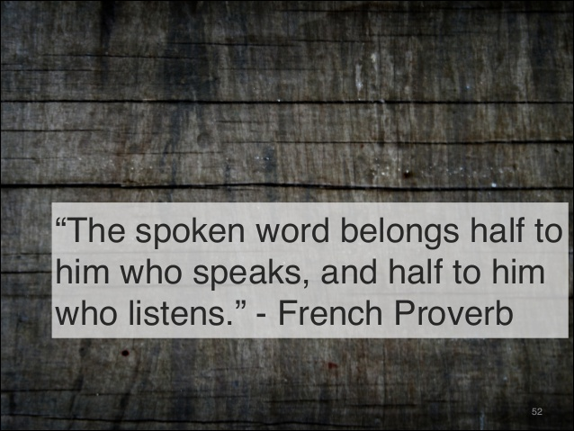
What is the role of listening in Oral Communication?

Slide 7
Why is this important?
Number one skill employers
look for when recruiting staff
Confederation of British Industry
Impacts upon outcomes – degree
classification, job outcome, social
interaction

Slide 8
What does it mean?
An act by which one gives or receives information
Intentional or unintentional
Can be achieved using a variety of modes

Slide 9
TASK: Over to you……
In pairs find out about your partner.
Interview each-other for the following details.
Make notes while the second partner answers.
Introduce your partner to the class
Name
Nickname
Birth Date
Place of birth
Education/studying
Goals
Skills
Hobbies
Goals in life
Job experience
Sports
Prizes/Awards/ Achievements
Travel experience
What makes this person unique?

Slide 10
Introduce your friend to the class.
Use the following statement to start.
I would like to introduce you to my friend ........... whose nickname is ...........”

Slide 11
Types of communication skills
Written
Verbal
Non verbal
Listening

Slide 12
Listening
Maintain eye contact
Do not interrupt
Build rapport
Clarifies situation
Do not make assumptions
Ask questions

Slide 13
Written communication skills
Application forms
CV
Cover letters
Reports

Slide 14

Verbal communication skills

Slide 15
Techniques for verbal communication skills
Speak clearly
Adapt to suit audience
Pitch, tone and speed
Eye contact
Non verbal cues
Prepare - confidence
Breathe!

Slide 16
The statistics
How do we judge people when we first meet
them?
55% on how we look
38% on how we sound
Only 7% on what we say

Slide 17
Non verbal
55%
Posture and eye contact
Facial expression
Gestures
Appearance

Slide 18
Listen to the Conversation and do the following?
What are the two speakers talking about?
Who is a better listener?
Who is the better speaker?
What is the best line you would like to use?
Do you use any of these communication skills, such as, friendliness, being very clear, listening with good non-verbal feedback, etc.)

Slide 19
TASK from the handout:
Make five groups and read the following topics respectively from page number 1 to 6 and make notes.
Finally share it with the class.
Group 1. IMPROVING YOUR SPEAKING SKILLS.
Group 2. HOW TO BE AN INTERESTING SPEAKER.
Group 3. EXERCISE ROUTINE TO FOLLOW TO DEVELOP FLUENCY.
Group 4. HOW TO HANDLE CLASSROOM SPEAKING TASKS.
Group 5. DIFFERENCE BETWEEN WRITTEN AND SPOKEN COMMUNICATION.

Slide 20

HOW GOOD A LISTENER YOU ARE!
WORK IN PAIRS.
Now each of you write a list of 5 topics you would like to speak about (some suggestions are your favorite movie, your hobbies, how much time do you spent on social media and what do you actually do, discuss any show you have seen recently if it is decent for the classroom, etc.)
Now give your list of topics to your partner. Let him/her select any one topic and talk about it for 1 to 2 minutes only.
Ok, now your job is to listen to your partner attentively and summarize his/her answer in front of the class.
The class will tell how good a listener you are.
Now you can speak on any one topic from your partner’s list and let’s see how good a listener your partner is.

Slide 21
Non verbal communication skills
Watch the following videos and make notes.
http://www.maximumadvantage.com/nonverbal-communication/non-verbal-communication-demonstration.html
http://www.youtube.com/watch?v=Ks-_Mh1QhMc

